Slide 1

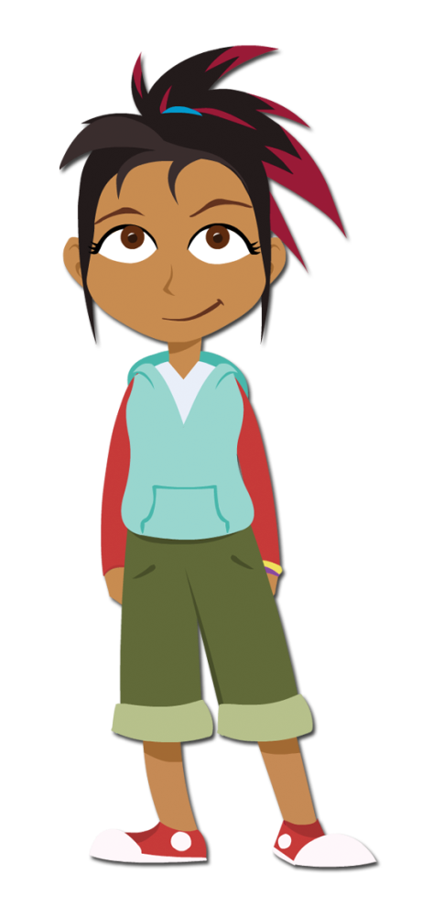





Train the Trainer
GETAS
Day 1
Dr. Barbara Billington
University of Minnesota
STEM Education
June 25-28, 2019

Slide 2



Role Model
Role Model video
https://vimeopro.com/user10550772/scigirls-in-space
Abby Sofia

Slide 3

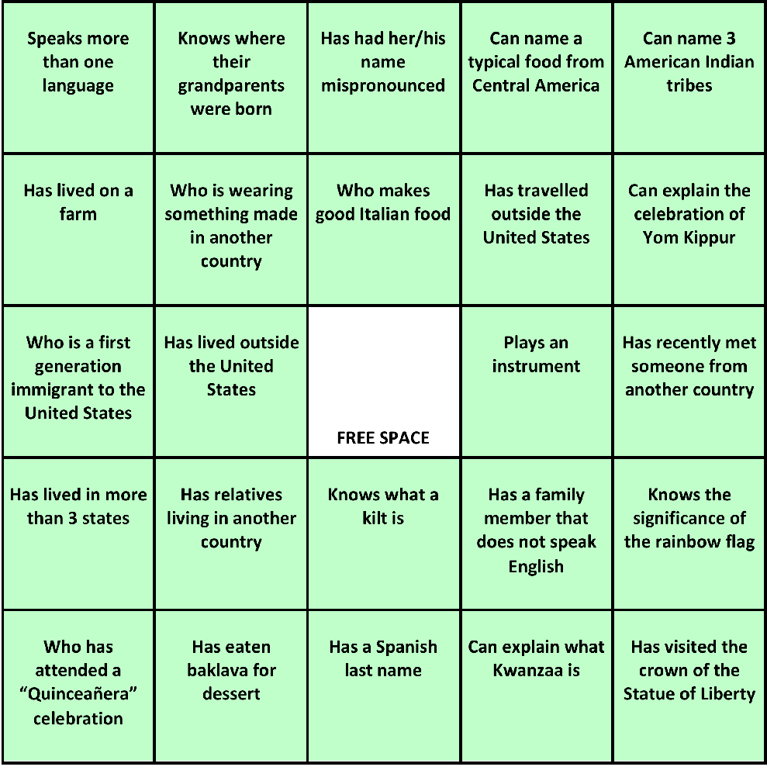
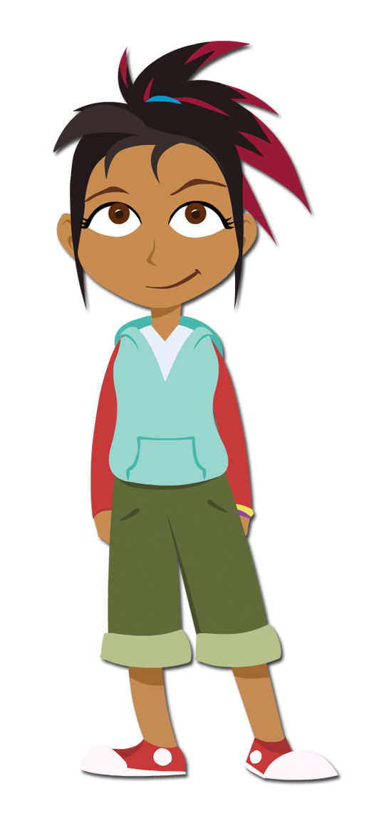

Cultural Bingo/ Ice Breaker
Notes:
3
Cultural Bingo introduces participants to the role of culture in their lives as they focus on exploring one’s own background and heritage. This activity will help participants become aware of the importance of developing cultural competence.
The purpose of this activity is to discover how much you know about other cultures and remind you of the cultural diversity that exists within the U.S.

Slide 4
TTT Workshop Overview
Introductions:
Your facilitators: Barb, Alex, Leah
What this Train-the-Trainer Workshop entails:
Introduction to SG Strategies, Themes, and “Training” modules
Daily Guest speakers at lunch time
Time to design and build your training for your context
Preparation for AY2019-2020
Nuts and Bolts:
Food, workshop time, parking, bathrooms etc…

Slide 5
Our Agenda for today
Role Models and overview – Brad Davey (Evaluator)
Introduction to the new SciGirls Strategies Guide
  Themes and Strategies
Lunch: Maribeth Romslo our guest speaker
Brief introduction to “Training” Modules 1 & 2
  Review your school/context data
Resources on Weebly and Facebook
Role Models revisited
Time for Personal Reflection/ Survey responses
Homework: Goal(s) for next year

Slide 6
GETAS Course Overview
  This course is designed to meet your needs… where each of you are at… we are looking for personalized learning goals and competency-based evidence and growth.

Slide 7
Review of SciGirls Strategies Guide
Take a 10 minutes to review the NEW Guide…
What do you notice?

Slide 8
Review of SciGirls Strategies Guide
Framework:
Create a STEM for ALL learning environment
Adopt CRP
Six Strategies:

Slide 9
Review of SciGirls Resources
Two resources ready to use
(find these links on the Links to Important Resources Google doc):
*Link to Weebly
*Log onto Facebook – Leah Defenbaugh

Slide 10
Review of SciGirls Strategies Guide
Review your responses to the GETAS Rubric
What needs do you have?
(See needs assessment)

Slide 11
Lunch
Guest Speaker:
Maribeth Romslo

Slide 12
Module A Overview
Engaging Diverse Learners – Culturally Responsive Practices
SG1: Connect STEM Experiences to girls’ lives.
  Relevance - STEM identity development
  Student-focused instruction

Slide 13
Defining Terms/ Creating Common Understandings
Culture
Culturally Relevant
Culturally Responsive
Relevance
Meaningful
Motivation
Engagement
Notes:
Small Group discussion

Slide 14

Culturally Responsive Teaching
CRT – is a pedagogy that recognizes, respects, and uses cultural characteristics, experiences, and perspectives of ethnically diverse students and backgrounds as meaningful sources for creating optimal learning environments and teaching them more effectively.
(Nieto 2000; Gay 2000).
Source: NSF
Notes:
14
What is CRT?
Have you practiced CRT?
CRT empowers and transforms students
CRT validates and incorporates the values, experiences, and cultural knowledge of students (Gay, 2000); it empowers students intellectually, socially, emotionally and politically by using cultural referents to impact knowledge, skills, and attitudes.
When students’ skills, knowledge and culture are included in teaching strategies it makes the information more personally meaningful and relevant to the student, has a higher interest appeal and are learned more easily and thoroughly.
If students are taught through their own culture and experiences the learning experience is meaningful.
Participating in CRT means that educators create a bridge between students’ home and school lives.
CRT utilizes the backgrounds, knowledge, and experiences of the students to inform the teacher’s lessons and methodology.
At the center of culturally relevant teaching is the culture of the student. To develop a program that is relevant to students, educators need to understand their core beliefs and experiences of their culture.

Slide 15
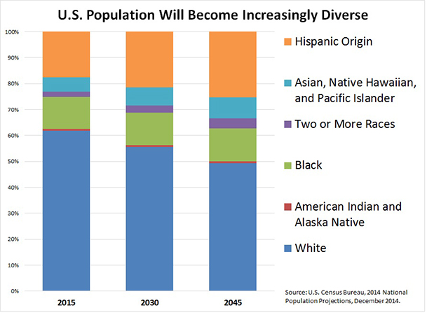
Diversity of U.S. Population
Notes:
15
The United States is undergoing a crucial demographic change. The U.S. is becoming more and more cultural and linguistically diverse. This change is as important to the 21st century as the baby boom was to the 20th century.
Projections by the U.S. Census Bureau, released in December of last year, show that the non-Hispanic White population which is currently the majority group, as it is both the largest racial and ethnic group and accounts for greater than a 50% share of the nation’s total population.
However, this population has been declining in recent years and by 2030, they’ll consititute about 55% of the population. By 2045 minorities are expected to be the majority. The majority-minority tipping point will occur in 2044. This is the point at which the non-Hispanic White population will comprise less than 50% of the nation’s total population and this country will become a majority-minority nation.

Slide 16
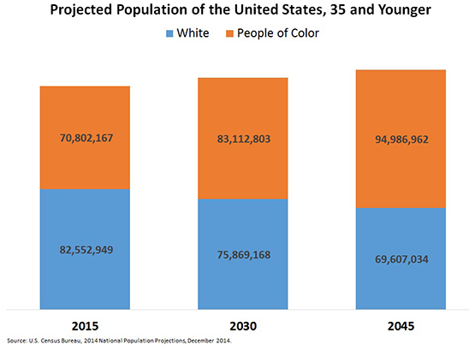
Diversity of U.S. Population
Notes:
16
This graph shows the projected population of young generations, 35 year olds and younger. Right now, Whites are the majority but by 2030, people of color will become the majority!
Interestingly, students with culturally and linguistically diverse backgrounds are the fastest growing population in U.S. schools.
Therefore it is important that educators have the ability to work effectively and successfully teach students who come from cultures other than their own.

Slide 17
YOUR CONTEXT:
Time to Explore your Data
In 3 ways
Course Name | Male (number) | Female (number) | % Female | Notes
Course name | White | Asian/Asian American | African/African American | Native American | Latino | Mixed/other | GPA Difference on Specific Assessment (project, test, exam etc...) | Notes
Course Name | Non EL | EL | GPA Difference on Specific Assessment | Notes
Notes:
17

Slide 18
Share your Data/Context
What did you learn?
How might this inform your training for teachers and counselors in your school/district next year?
What goals does this potentially inspire?
How might your responses to the GETAS Rubric also inspire your future PD?
Notes:
Small Group discussion

Slide 19
Module 2 Overview
Role Models
SG6: Provide opportunities for girls to interact with and learn from diverse STEM role models.

Slide 20
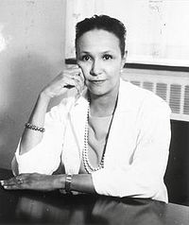
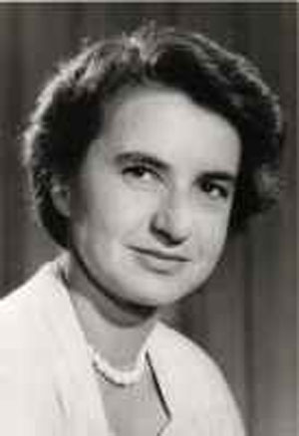
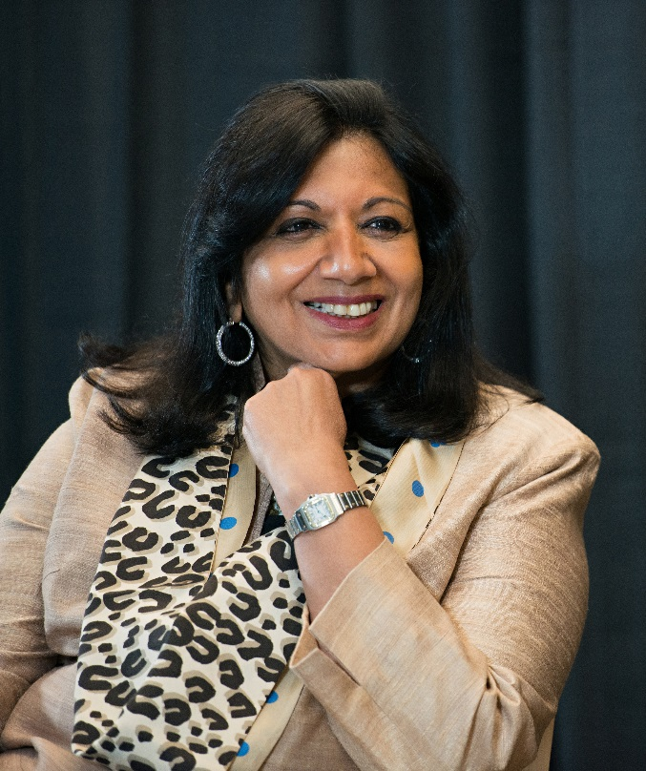
Do you recognize these famous women scientists?
Photo Source: Wikipedia
Photo Source: The National Library of Medicine
Photo Source: Chemical Heritage Foundation
Notes:
Rosalind Franklin (Xray Crystallographer)– Jane Cooke Wright (Chemotherapy research)--- Kiran Mazumdar-Shaw (chairman biotech)
(1920-1958) photo credit: The National Library of Medicine via Wikimedia Commons
Franklin was an English chemist and X-ray crystallographer who made contributions to the understanding of the molecular structures of DNA (deoxyribonucleic acid), RNA (ribonucleic acid), viruses, coal, and graphite.^{[2]} Although her works on coal and viruses were appreciated in her lifetime, her contributions to the discovery of DNA were largely recognized posthumously.
Jane Cooke Wright (1919-2013) photo credit: Wikipedia. Wright was an African-American pioneer in cancer research and chemotherapy
Led effort in discovering several chemotherapeutic drugs. First woman president of New York Cancer Society
Kiran Mazumdar-Shaw (born 23 March 1953, Bangalore, India) is an Indian entrepreneur. She is the chairman and managing director of Biocon Limited, a biotechnology company based in Bangalore (Bengaluru), India they develop biopharmaceuticals. In 2014, she was awarded the Othmer Gold Medal, for outstanding contributions to the progress of science and chemistry. She is on the Financial Times’ top 50 women in business list. As of 2015, she was listed as the 85th most powerful woman in the world by Forbes.

Slide 21
Why is it Important?
Comparison of Careers in STEM 1960-2000
(Hill, Corbett, & St. Rose, 2010).
Notes:
SEE ALSO: The table on page 4 of the SciGirls 7 Guide.
Statistics From:
1. Bureau of Labor Statistics (BLS) 2011. Women in the Labor Force: A Databook.
Report 1018. Washington, DC: US Department of Labor, September 2009.
2. National Science Board (NSB) 2008. Science and Engineering Indicators 2008.
Two volumes. Arlington, VA: National Science Foundation (volume 1, NSB 08-01; volume 2, NSB 08-01A).
3. Ashcraft, Catherine, and Blithe, Sarah 2009. Women in IT: The Facts 2009. National Center for Women in Information Technology (NCWIT)
4. Scientific American (2013). Gender Gaps: Women are more likely than men to withdraw from science. P. 88

Slide 22

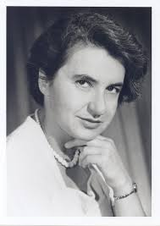
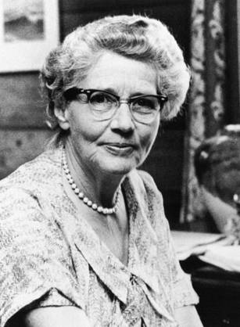
The SciGirls Seven:
Explicit Instruction on Gender Inequities
Rosalind Franklin
1920-1958
Photo Credit: National Library of Medicine
Helen Taussig
1898-1986
Photo Credit: National Library of Medicine: www.nlm.nih.gov
Notes:
Rosalind Franklin (1920-1958) – PhD in Physical Chemistry in 1945. Worked at Kings College with Maurice Wilkins. Not seen as his equal. Photograph 51 led Watson and Crick to solve the structure of DNA shortly after seeing it.
Helen Taussig (1898-1958) – Director of Pediatric Cardiology at Johns-Hopkins Children’s Heart Clinic in 1930. She literally wrote the book on congenital heart defects. Read short quote from p. 19-20 about Taussig.
OR Quote from American Experience TPT site…“Taussig completed her B.A. at the University of California at Berkeley in 1921. In pursuing a medical career, Taussig encountered daunting obstacles and discrimination. She enrolled in Harvard's School of Public Health, but women could not get a degree there. Taussig needed special permission to take courses at Harvard's medical school, which did not admit women until 1945. Her anatomy professor at Boston University suggested that she focus on the heart, and apply to medical school at Johns Hopkins.” http://www.pbs.org/wgbh/amex/partners/legacy/l_colleagues_taussig.html

Slide 23

The SciGirls Seven:
Resources: Explicit Instruction on Gender Inequities
  Rachel Swaby’s Headstrong:
  52 Women Who Changed Science – and the World
Notes:
Rachel Swaby, a journalist who decided to research women scientists and write this book (2013) after an obituary for Yvonne Brill appeared in the NY Times. It began: “She made a mean beef stroganoff, followed her husband from job to job, and took eight years off from work to raise three children.” Oh yeah, and she won the National medal of Technology and Innovation for her invention of rocket propulsion systems that kept communication satellites in orbit.

Slide 24

The SciGirls Seven:
Resources: Explicit Instruction on Gender Inequities
  “…sexism has been something very simple:
  the cumulative weight
  of constantly being told
  that you can’t possibly be what you are.”
  p. 182-183

Slide 25


But what’s EVEN BETTER
than
stories about
women in STEM?

Slide 26
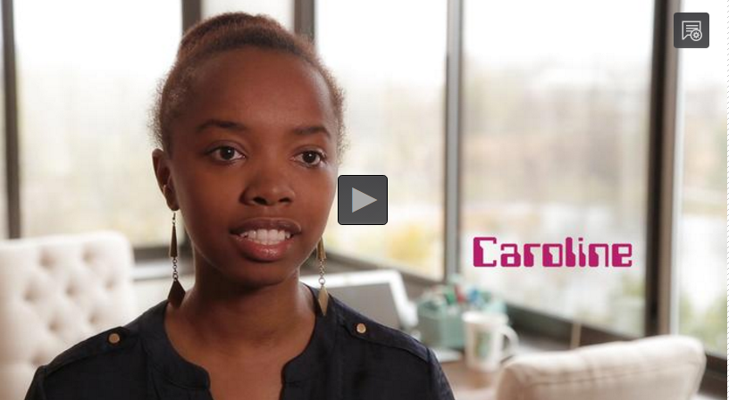
Share a Female STEM Role Model
Notes:
Caroline video is in my ITEST/SPPS folder. It’s 3:55 long.
There are 12 Role Model videos – listed on the SciGirls Profiles: Women in STEM card – you can use them in your classrooms. Please do!

Slide 27
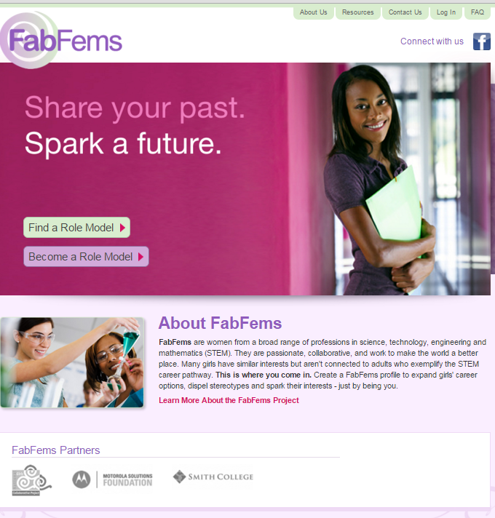
Invite a Role Model: FabFems.org

Slide 28
Share a Female STEM Role Model
scigirlsconnect.org/groups/ role-models/

Slide 29
GETAS in CTE/STEM
How are you already including Role Models in your classes/ schools?
  Share your practice in Small Groups and on Facebook
Increase awareness of the barriers and challenges to girls and students of color in STEM/CTE and be prepared to provide resources.

Slide 30
Train the Trainer
GETAS
Day 2
Dr. Barbara Billington
University of Minnesota
STEM Education
June 25-28, 2019

Slide 31
Role Model
Role Model video
  https://vimeopro.com/user10550772/scigirls-profiles-latinas-at-work
Amelia Merced

Slide 32
Our Agenda for today
Role Models and Revisit survey/feedback
Brief introduction to “Training” Modules 3 & 4
  Resources on Weebly and Facebook and Google Folders
Lunch: our guest speaker – Brad Davey
How will you reach your goals?
Resilience Activity
Work Time
Role Models revisited
Time for Personal Reflection/ Survey responses
Homework:

Slide 33
Module 3 Overview
Collaboration
SG5: Emphasize that STEM is collaborative, social and community-oriented.
Revisit/tie-in of SG1
Student focused instruction

Slide 34
Module 3 Overview
Community-Oriented and Social
i.e. Ice Breakers
Put Yourself on the Line

Slide 35
Module 3 Overview
  Building a safe and welcoming learning environment
  Build-relationships between the teacher and students and between the students themselves.
  Class forming a collective identity – we are in this together.
    Perhaps instead of competing between students in the class, each class could compete with other classes.
  Share how you do this in your classes

Slide 36
Module 3 Overview
  Collaboration/ Group Work
  Selecting appropriate task for group
    procedural AND intellectual
  Selecting groups – putting students in groups
    numbering or intentional/ base groups
  Fostering Student Participation
    divide roles, ask for clarification
  Planning for Assessment and Accountability
    all participants accountable for information when sharing out

Slide 37
Small Group work – Modeled
Number off: 1, 2, 3
Building…
Notes:
37

Slide 38
Module 3 Overview
  Debrief Paper Chain Activity
  What strategies do you use to help groups succeed?

Slide 39
Module 4 Overview
Self-Confidence
SG3: Empower girls to embrace struggle, overcome challenges, and increase self-confidence in STEM.
Growth Mindset
Carol Dweck

Slide 40
Module 4 Overview
Growth Mindset YouTube

Slide 41
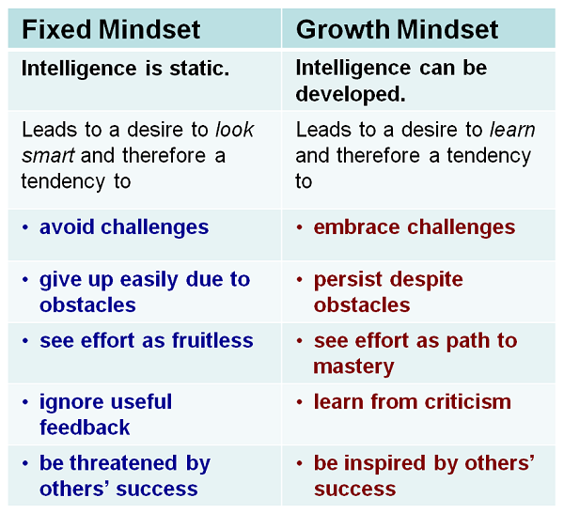
Module 4 Overview
Dweck
Notes:
Teach children that intellectual skills can be acquired.
Praise children for effort.
Highlight the struggle.
Gifted and talented programs should send the message that they value growth and learning.

Slide 42
Module 4 Overview
Dweck recommends:
  Teach students that intellectual skills can be acquired.
  Praise students for effort.
  Highlight the struggle.
  Send the message that we value growth and learning.

Slide 43
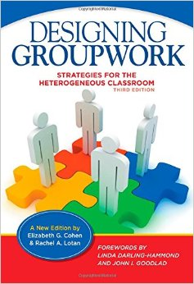
Module 3 & 4 Combined
Designing Groupwork for respectful conversation and equitable learning
Elizabeth Cohen & Rachel Lotan’s book

Slide 44
Module 4: Growth Mindset Resources
Four Resources on Weebly
Carol Dweck: TED Talk and Blog on Growth Mindset
Ellen Langer: Mindfulness
Catherine Amelink: Female Interest in Mathematics
Ceci et al: Why Aren’t More Women in Science?
Your Task…Create a visual with a partner that illustrates the difference between a Fixed Mindset and a Growth Mindset

Slide 45
TTT Resources
Online Resources for TTT
Weebly Site
Facebook
Google Folders

Slide 46
Lunch
Guest Speaker:
Dr. Brad Davey

Slide 47
Seeing White
Share impressions, thoughts, ideas, questions from the Seeing White podcast

Slide 48
How will you reach your goals?
What specifically do you plan to do?
  What’s your training going to look like?
  Are teachers meeting 2x a month? In the summer? All year?
  How many teachers are on board? How many more do you want?
What support will you provide as a trainer/ teacher? Begin to map out the year
How have counselors been recruiting girls to CTE/STEM courses?
  How can you and the teachers you work with expand on/grow this?

Slide 49
Work Time with Support
Find the planning documents in your Google Folder
  Revisit your Goal Setting doc
  Begin to plan your Training
Review Resource on Weebly
Consider your role as coach
On a sticky note – what support will you need tomorrow.

Slide 50
Role Model
Role Model video
  https://vimeopro.com/user10550772/scigirls-profiles-latinas-at-work
Orietta

Slide 51
Train the Trainer
GETAS
Day 3
Dr. Barbara Billington
University of Minnesota
STEM Education
June 25-28, 2019

Slide 52
Role Model
Role Model video
“Seven”

Slide 53
Our Agenda for today
Role Models and Revisit survey/feedback
Brief introduction to “Training” Modules 5 & 6
  Resources on Weebly and Facebook and Google Folders
Lunch: our guest speaker – Marie Domingo
How will you reach your goals?
Work Time
Role Models revisited
Time for Personal Reflection/ Survey responses
Homework:

Slide 54
Module 5 Overview
Solving Problems
SG2: Support girls as they investigate questions and
solve problems using
STEM practices.
8 NGSS Science and Engineering Practices
Creativity is part of the “nature of science”

Slide 55
Module 5 Overview
“Student questions are the seeds of student learning.”
Ramsey Musallam

Slide 56
Module 5 Overview
Asking your Students to Solve Problems… requires a shift in our thinking…
We must be facilitators and guides not directors.

Slide 57
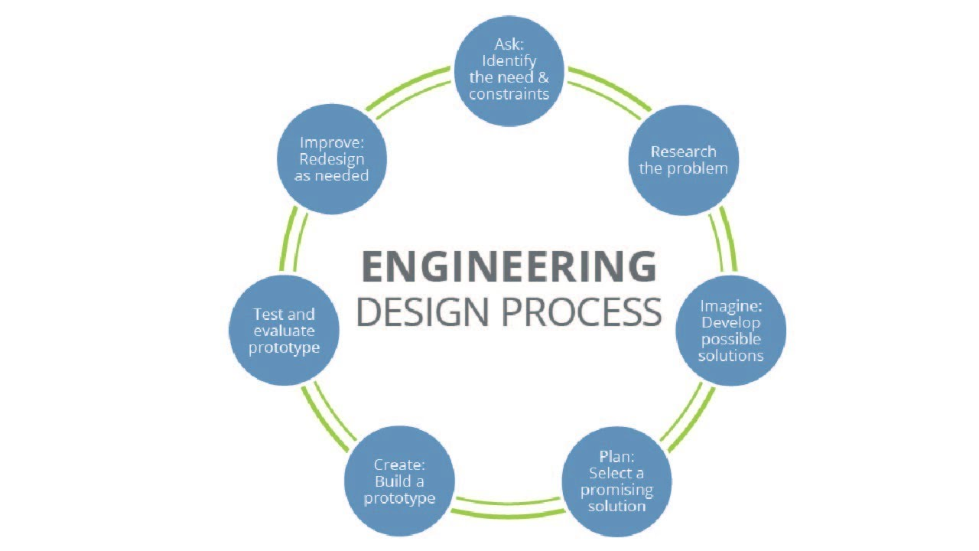
Module 5 Overview
Notes:
TeachEngineering.org
https://www.teachengineering.org/k12engineering/designprocess

Slide 58
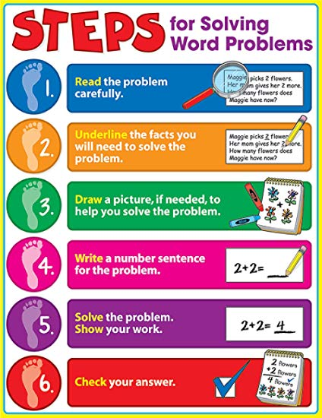
Module 5 Overview
Notes:
Carson Dellosa Steps for Solving Word Problems Chart

Slide 59
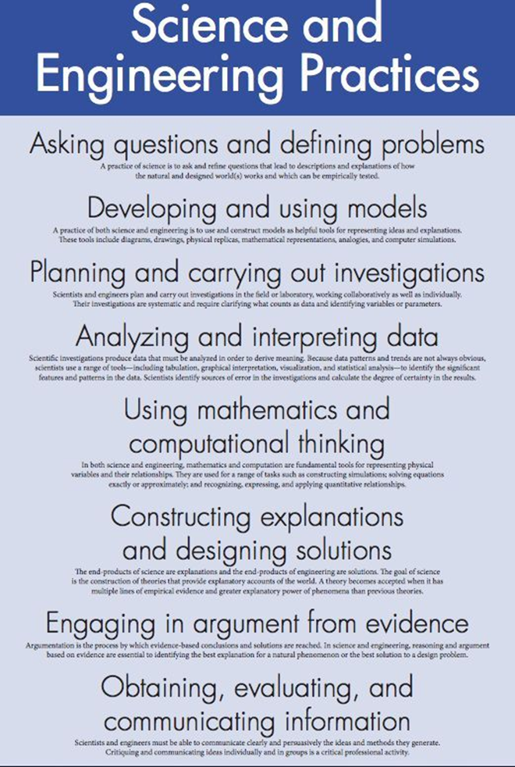
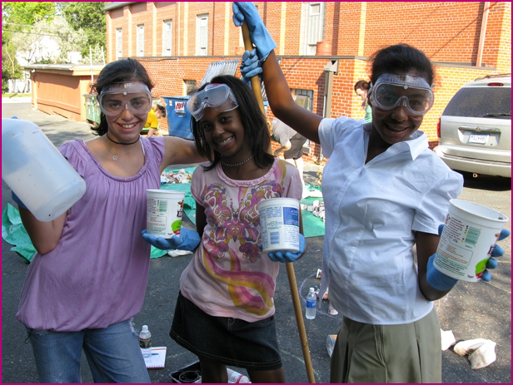
Notes:
59

Slide 60
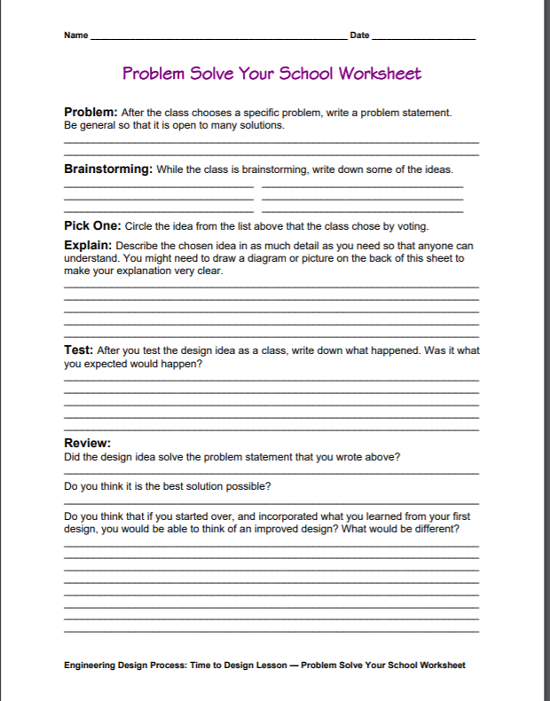
Module 5 Overview
Notes:
https://www.teachengineering.org/activities/view/cub_design_lesson01_activity2

Slide 61
Module 5 Overview
Provide activities and templates to help girls organize their problem solving.
What activities do you already do?
When students ask “why” this can spark their curiosity!
Notes:
https://www.teachengineering.org/activities/view/cub_design_lesson01_activity2

Slide 62
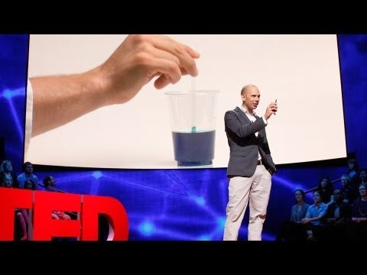
Module 5 Overview
Three Rules that Spark Learning:
Curiosity comes First, Embrace the Mess, Practice Reflection
Notes:
https://www.ted.com/talks/ramsey_musallam_3_rules_to_spark_learning?language=en

Slide 63
Module 6 Overview
Challenging STEM/CTE Stereotypes
SG4: Encourage girls to identify the challenge of STEM stereotypes.
Thoughtful communication
Sounds counterintuitive – research supports this approach

Slide 64
Module 6 Overview
Take a moment to draw a scientist (or engineer or mathematician or mechanic) in their work environment.

Slide 65
Module 6 Overview
DAST
Popular study since the 1960s.
1970s only 1% drew female scientist
What % drew female scientists in 2018?
30% (but this is uncommon)
Notes:
https://www.washingtonpost.com/news/speaking-of-science/wp/2018/03/20/only-3-in-10-children-asked-to-draw-a-scientist-drew-a-woman-but-thats-more-than-ever/?noredirect=on&utm_term=.79ff9a8b43ff

Slide 66
Module 6 Overview
Provide examples of what STEM looks like for professionals
Incorporate materials, images, content that counter stereotypes.
Point out that doing STEM/CTE and being a STEM or CTE person does not have to contradict how girls see
themselves.
Be Explicit when providing
the counter-narrative.
Notes:
https://www.scientificamerican.com/article/as-climate-scientists-speak-out-sexist-attacks-are-on-the-rise/
As a female climate scientist spoke out against climate change, she was subject to sexist remarks, i.e. Climate Barbie.

Slide 67

Module 6 Overview
Help girls begin to identify as a STEM or CTE person.
Notes:
https://500womenscientists.org/updates/2017/11/13/outside-the-box
Image from:
https://www.aauw.org/2016/03/25/bias-in-marine-biology/

Slide 68
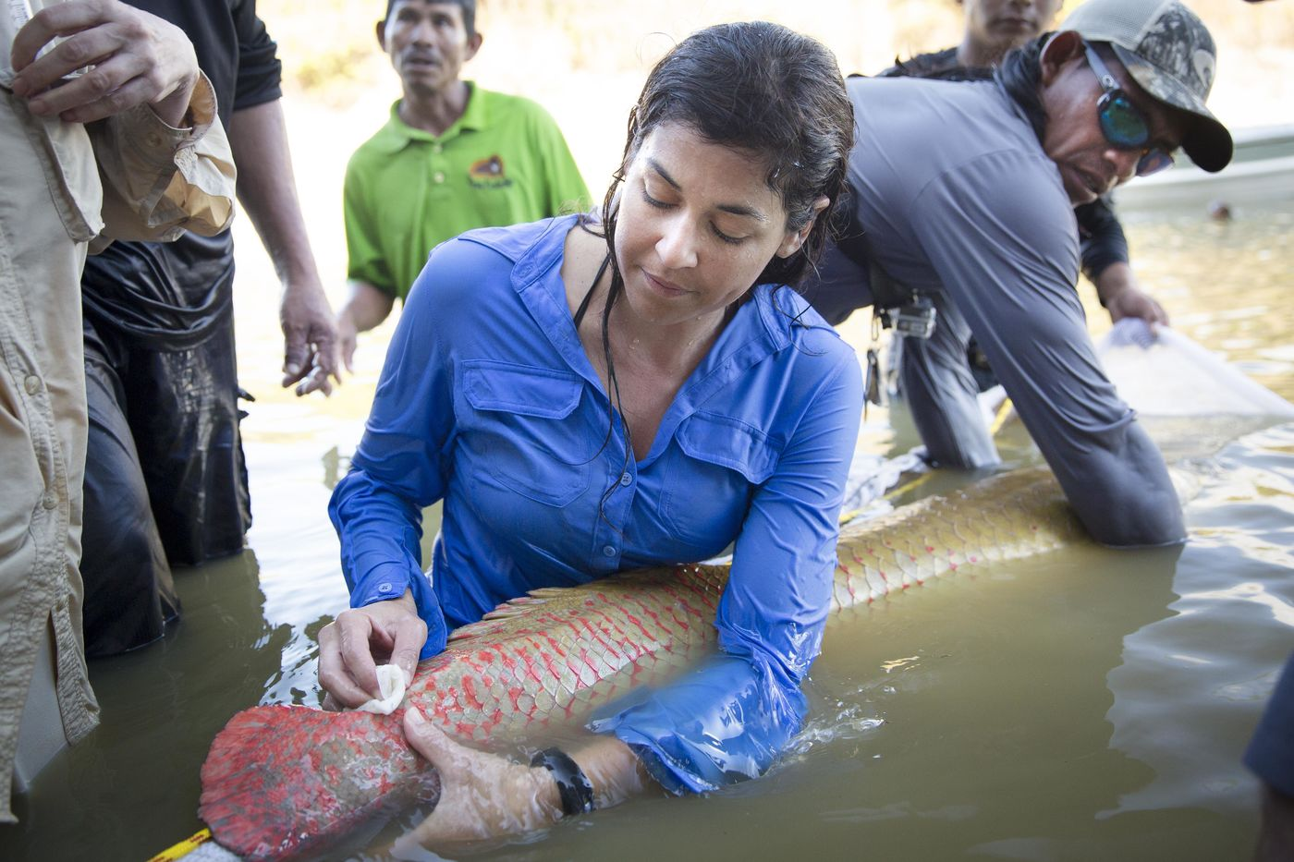
Module 6 Overview
Remind girls when they are doing the work in your class they are scientists, or engineers, or mathematicians… give them the TITLE during class.
Notes:
Image from: https://www.fieldmuseum.org/blog/women-science-lesley-de-souza-conservation-biologist
Conservation Biologist – Lesley DeSouza

Slide 69
Lunch
Guest Speaker:
Marie Domingo
SciGirls Snapshots
Role Models

Slide 70
Work Time
Work Time on your PD plans – how can we help?
Revisit Weebly resources or Facebook etc...
Mapping the year, goals, supports, plans
Checking for inclusion of counselors, administrators, parents, community stakeholders in expanded vision of STEM/CTE participants
We will share in an hour

Slide 71
Small Group Share out
Work Time Share Out
What will your PD look like?
What data will you be collecting?

Slide 72
Role Model
Role Model video
“Rachel – Bicycle”

Slide 73
Train the Trainer
GETAS
Day 4
Dr. Barbara Billington
University of Minnesota
STEM Education
June 25-28, 2019

Slide 74
Role Model
Role Model video
“Victoria Velez”

Slide 75
Our Agenda for today
Role Model video/ Revisit survey/feedback
Final Day Kick Off
Work Time
  Main deliverable due end of day today
Lunch: our guest speaker – Dr. Brad Davey (Evaluator)
Big Share Out
How can we support you with Webinars?
Role Models revisited
Time for final reflection/survey responses

Slide 76
Work Time
Finalizing PD Plan
How ready do you feel to implement this training in the fall?
What data will you collect?
What will your team be expected to document?
What tech tools will you use?

Slide 77
Lunch
Guest Speaker:
Dr. Brad Davey
Evaluator
of this SciGirls program

Slide 78
Big Share Out prep
Take some time to respond to this statement in writing:
I will do __________ and it will impact ______ in terms of _____.

Slide 79
Monthly Webinars
How can we help?
What topics would you like support in for the monthly webinars?
What do anticipate being the biggest challenge(s) for your team’s PD?

Slide 80
Role Model
Role Model video
“Pallavi Sharma”

Slide 81



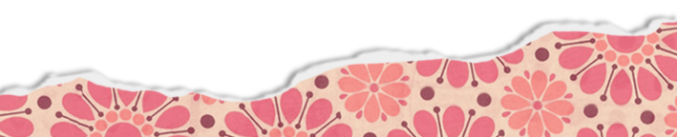


Thank you!
Barbara Billington
University of Minnesota
bill0041@umn.edu

